Slide 1
Week 2: Introduction to XAML and Basic XAML Layout
.NET Development Workshop Series

Slide 2
C# Revision
Recap on last week

Slide 3
C# Revision
What does try…catch… do?
Terminates the program safely when an exception/error occurred.
Prints out the error message for the user when an exception/error occurred.
Capture the error type and handles the error/exception with an alternative code.
Capture the error type and continue running the software.

Slide 4
C# Revision
What is the difference between List<T> and Dictionary<T, T>?
List<T> stores only data of the same type while Dictionary<T,T> allows different data types to be stored.
List<T> allows different data types to be stored while Dictionary<T,T> stores only data of the same type.
Accessing element of List<T> can accept index in of different object types while Dictionary<T, T> requires index in int.
Accessing element of List<T> requires index in int while Dictionary<T, T> can accept index in of different object types.

Slide 5
C# Revision
Try opening up your Visual Studio and write a block of code to show the usage of a for each loop!

Slide 6
Introduction to XAML
WinForms UI Design

Slide 7


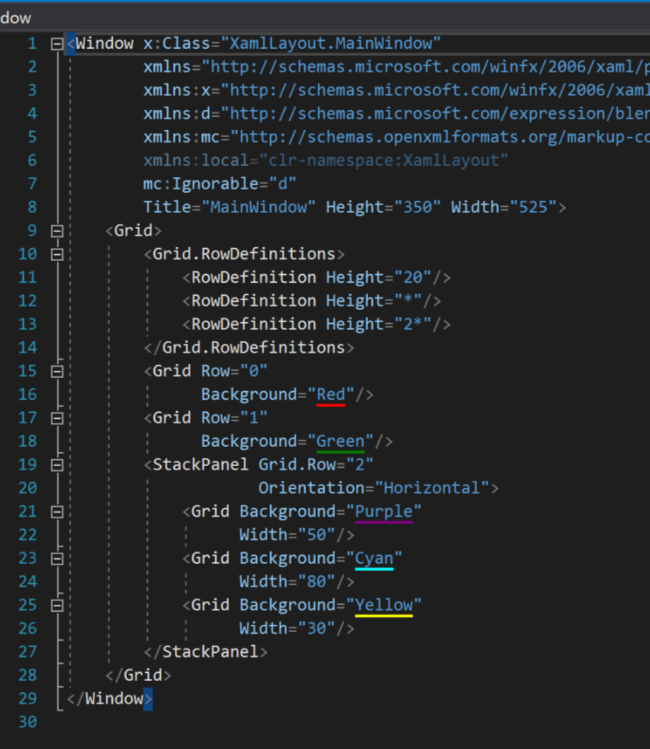

Example XAML
z
z

Slide 8
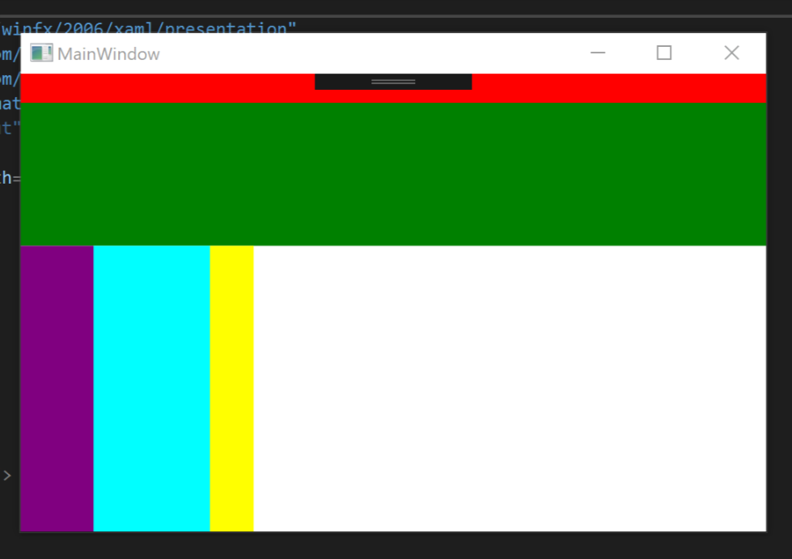
Layout for Example
z
z

Slide 9
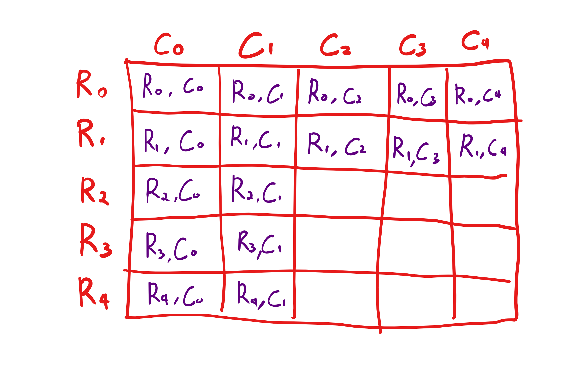
What is Grid?
z
Grid can be imagined as a bunch of boxes arranged in Rows and Columns.
Each component has to be specified on which Row or Columns to be placed. (Default is Row 0, Column 0)

Slide 10
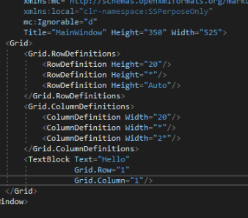
How to do Grid?
z
z

Slide 11
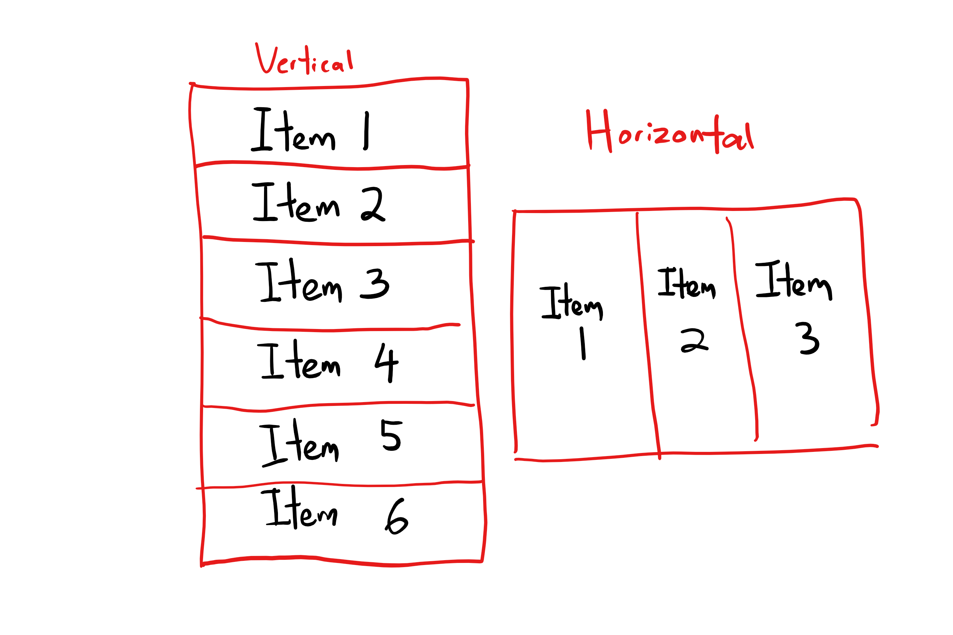
What is StackPanel?
z
StackPanel is a layout type that allows components to stack side by side.
Components does not need to specify row or column, but the sequence of the code would determine the sequence of the components.

Slide 12
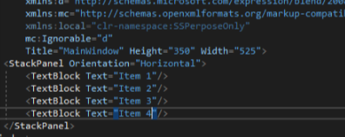
How to do StackPanel?
z
z

Slide 13
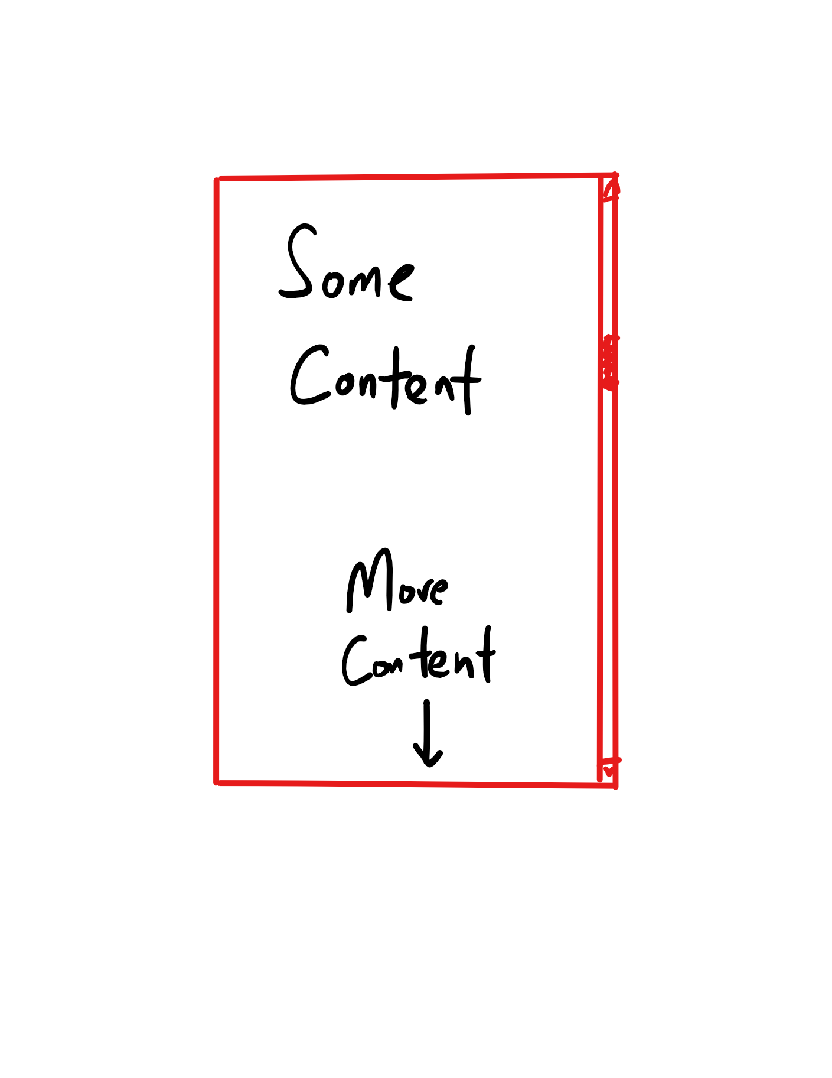
What is ScrollViewer?
z
ScrollViewer allows user to scroll through contents that are larger than the display size allocated (usually the screen size).

Slide 14
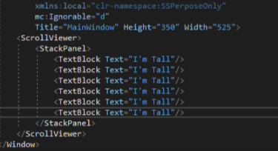
How to do ScrollViewer?
z
z

Slide 15
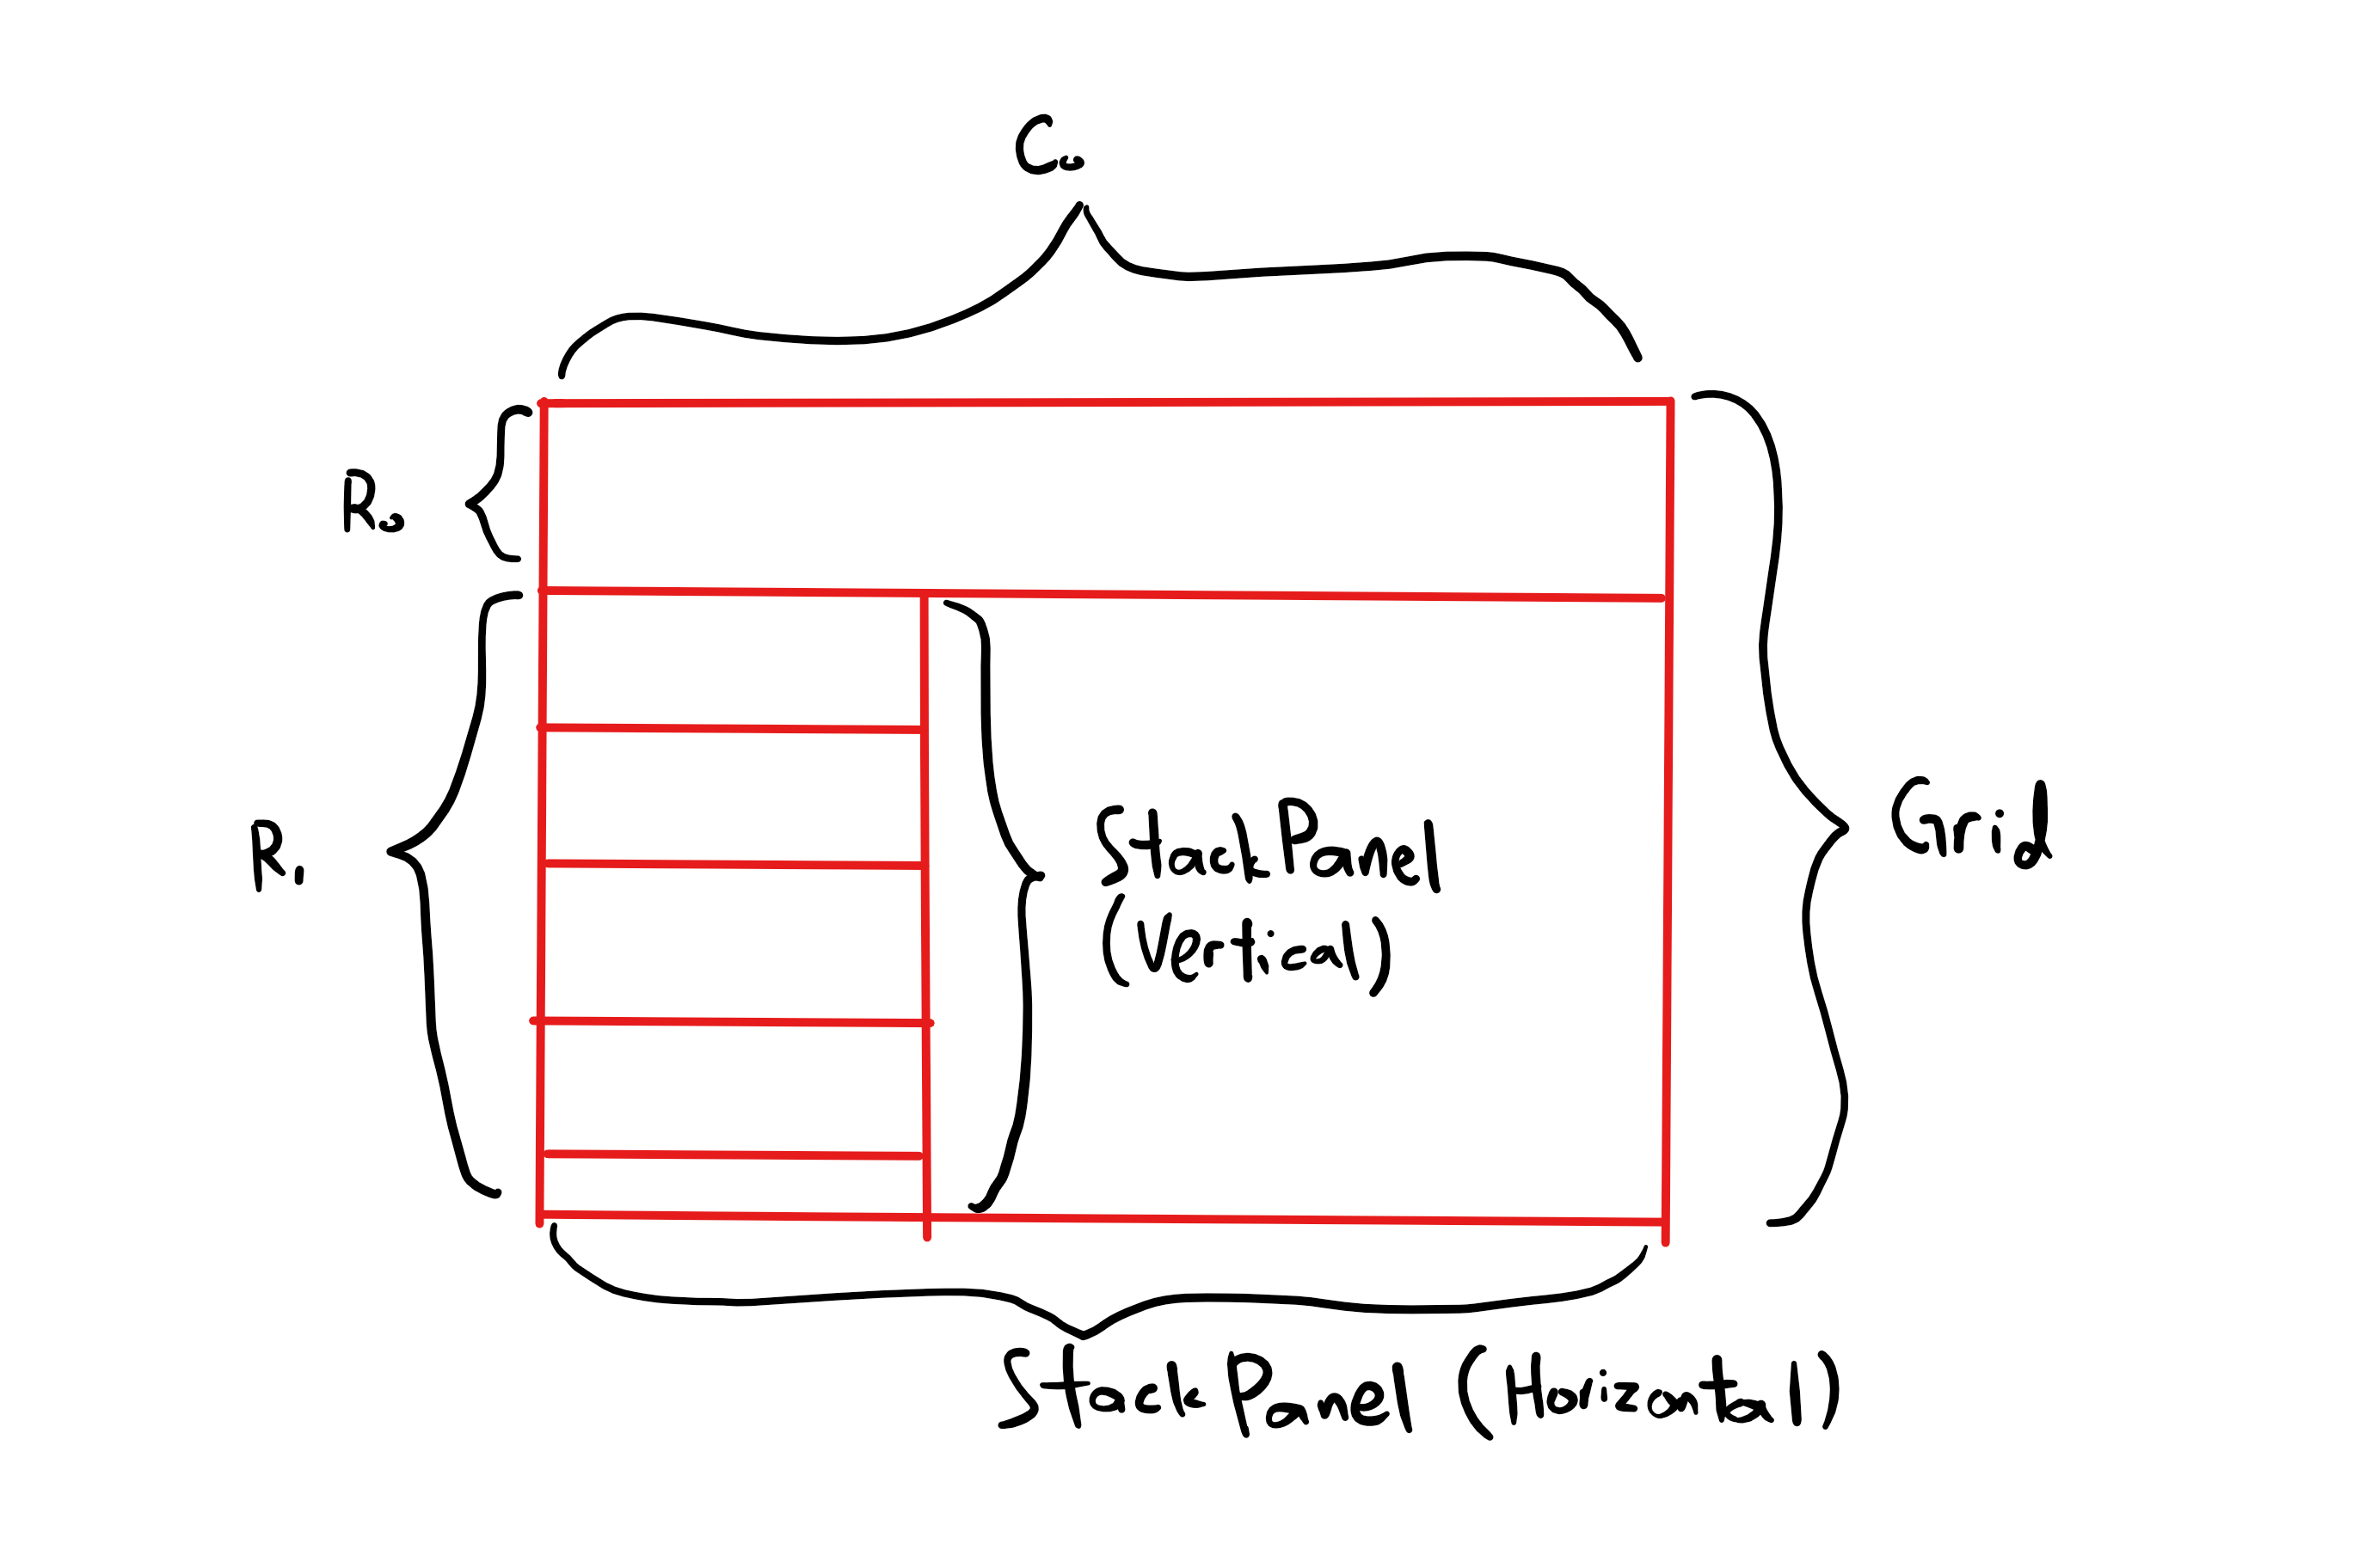
Creating a more intermediate Layout
z
Layouts can be nested inside another layout to create a more robust layout.
There’s no specific solution on every layout. Use your creativity to create different types of layout!

Slide 16
Quick Recap
Summarize what you just learnt.

Slide 17
Quick Recap
Which of the following is a StackPanel?
1
2

Slide 18
Quick Recap
What does the character ‘ * ’ means in RowDefinitions or ColumnDefinitions?
All of the remaining space
Half of the remaining space
One ratio of the remaining space
1 pixel

Slide 19
Task
Get your hands dirty and try out the Layouts you’ve just learnt!

Slide 20
Next Week…
More on XAML UI designing
Creating different types of pre-defined components in XAML

